Slide 1
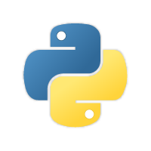
Introduction to Python

Slide 2
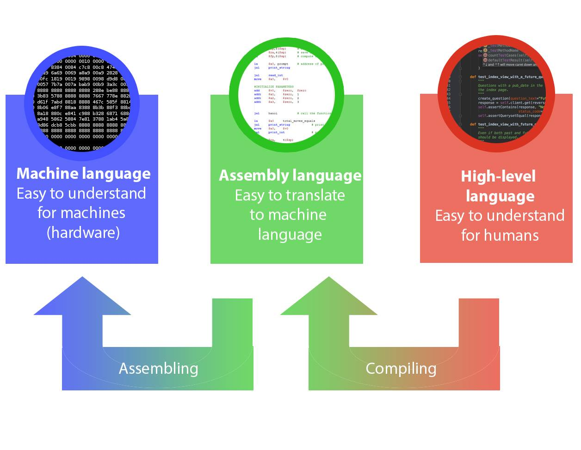
What is a programming language?

Slide 3
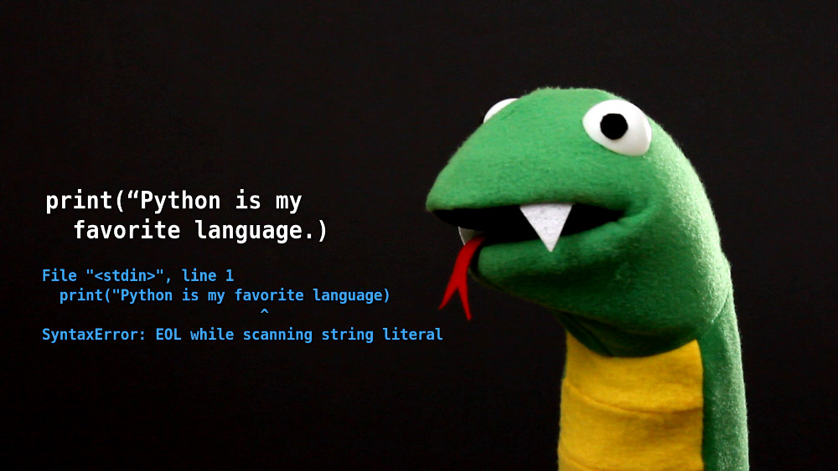
What is Python?

Slide 4
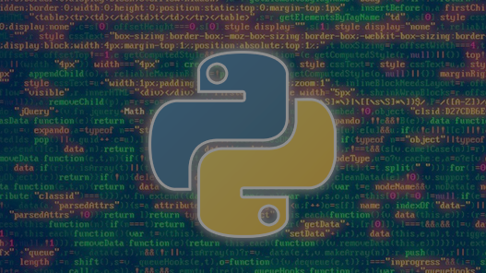
General Purpose programming language
Dynamically typed language
Two most popular versions: Python 2.7 and Python 3.5

Slide 5
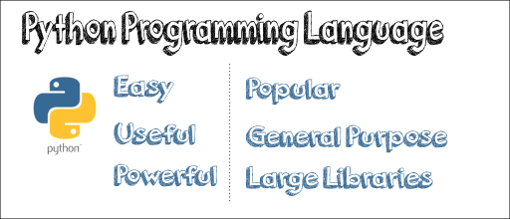
Why Python?

Slide 6
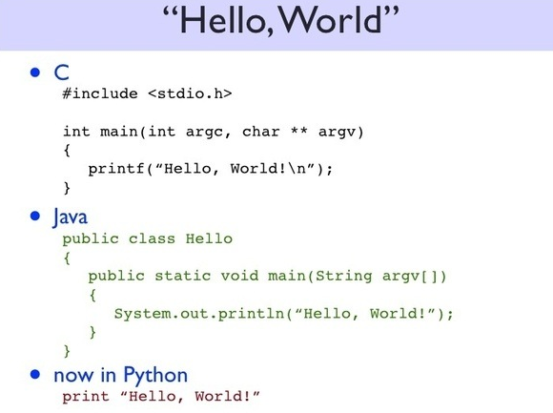

Slide 7
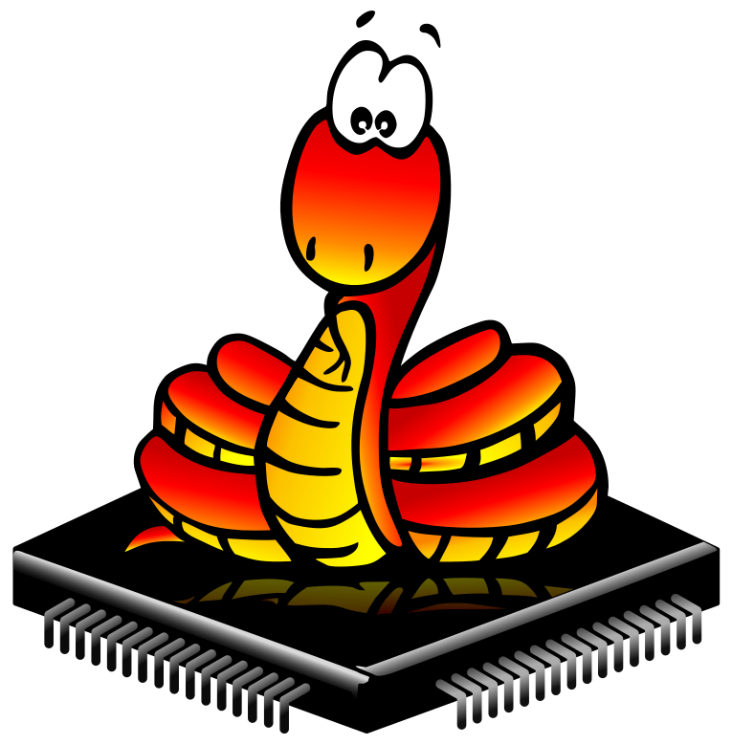
MicroPython?
full Python 3 compiler, written in C
runs on the micro-controller hardware.
selection of core Python libraries
modules which give access to low-level hardware.

Slide 8
